Slide 1



Revenue and Profitability Insights
for
Strategic Growth
Olumide Balogun +234-8065060691

Slide 2


Table of Contents
Executive Summary
Objectives of the Project
Business Questions: A Comprehensive Examination of Descriptive, Diagnostic, Predictive, and Prescriptive Analytics
Tools Used throughout the Project
Approach, Analysis, and Technical Challenges
Key Findings: Objectives, Insights, EDA Visualizations, and Model-Driven Interpretations
Final Recommendations
Olumide Balogun +234-8065060691
2

Slide 3

Executive Summary
This end-to-end, R-powered analytics project delivers a comprehensive 360-degree view of business performance from 2020 to 2023, offering deep insights into sales trends, profit dynamics, customer behavior, and market performance. By seamlessly integrating diagnostic, predictive, and prescriptive analytics, the project evaluates key revenue and profitability drivers across product lines, customer segments, market zones, and sales channels. The result is a robust, data-driven framework that not only uncovers underlying performance patterns but also delivers actionable recommendations to boost profitability, enhance operational efficiency, and support sustainable growth and strategic agility.
Key Insights
1. Performance Trends
2021 marked an explosive growth year, with revenue surging by +337%, profit by +247%, and volume by +323%, driven by aggressive expansion and efficient execution.
2022 presented a profitability paradox, despite declines in revenue (–17%) and volume (–15%), profit increased by +9%, suggesting effective cost-control strategies and margin focus.
2023 saw a rebound in sales performance, with revenue and volume recovering, but a –24% decline in profit raised red flags around rising costs and pricing inefficiencies.
2. Revenue & Profitability Drivers
Cost Price and Profit are the most significant drivers of revenue, not volume or geographical presence, highlighting the importance of operational efficiency and pricing strategy.
Own Brand products consistently outperformed across all metrics, showing strong customer loyalty, brand equity, and profitability.
Brick & Mortar remains the most profitable channel, while Click-and-Mortar offers a lean, scalable hybrid model with strong efficiency metrics.
North-Central emerged as the top-performing region in both revenue and profit, with South-West contributing significantly—though both together account for 70% of total revenue, revealing a concentration risk.
E-Commerce, North-East, and South-South regions are under-leveraged, offering untapped opportunities for digital expansion and market diversification.
Olumide Balogun +234-8065060691
3

Slide 4
3. Forward-Looking Insight
Forecasting models suggest a revenue plateau by 2026, underscoring the need for innovation, market expansion, and new product strategies to reignite sustainable growth and reduce reliance on legacy channels or regions.
Strategic Recommendations
Replicate 2021 strategies across high-potential segments and regions to reignite rapid growth.
Conduct margin diagnostics to address 2023’s profit dip and identify cost-saving opportunities.
Prioritize high-margin products like Own Brand & Custom-Made, especially in Click-and-Mortar channels.
Revamp E-Commerce strategy and expand digital reach in underperforming regions.
Reduce over-reliance on top zones by investing in South-East & North-West market development.
Adopt predictive analytics for revenue, cost, and customer trends to drive real-time decisions.
Expected Business Impact
1. Growth & Profitability:
Increase revenue by 15–20% and boost profit by 8–12% through strategic scaling and margin optimization.
Reduce revenue stagnation by 10% via better product and customer targeting.
2. Operational Efficiency:
Improve resource allocation by 20% and forecasting accuracy by 25% using ARIMA models.
Enhance customer retention by 12% through data-driven segmentation and engagement.
3. Market Expansion & Sales:
Grow market penetration by 10–15% in emerging regions.
Raise digital sales by 7–10% and increase cross-/upselling by 15% with refined customer insights.
Olumide Balogun +234-8065060691
4

Slide 5

Objectives of this Project
This project aimed to leverage advanced analytics to empower the company's strategic decision-making processes. Key objectives included:
Diagnose historical revenue and profit trends to understand the organization’s financial trajectory from 2020 to 2023.
Identify key performance drivers (products, customer types, market zones, and channels) contributing most to revenue and profitability.
Uncover inefficiencies and performance gaps by analyzing year-over-year changes in volume, revenue, and profit.
Leverage advanced analytics (R, machine learning, and time-series forecasting) to generate forward-looking insights that inform strategic decision-making.
Support business leaders with actionable recommendations to:
Improve pricing strategies,
Optimize product and channel mix,
Strengthen regional market penetration,
Boost customer retention and operational efficiency.
Develop a data-driven roadmap that ensures sustained growth, profitability, and competitive advantage in a volatile market.
Olumide Balogun +234-8065060691
5

Slide 6

Business Questions: A Comprehensive Examination of Descriptive, Diagnostic, Predictive, and Prescriptive Analytics
Did any years experience negative or stagnant growth? Furthermore, are there significant differences in the data?
Which customer types, product types, and market zones rank among the top 20 with total revenue surpassing $4.00 million?
Which customer types, product types, and market zones rank among the top 20 with total profits exceeding $0.06 million?
Is there a clear upward or downward trend in performance over time?
How do revenue and profitability differ across various market zones?
How do revenue and profit vary across different product types?
How do revenue and profit vary across different customer types?
What are the strengths and directions of relationships between key business variables, and which of these correlations are statistically significant?.
What Key Drivers Contribute to Revenue Performance?
10a. What are the seasonal patterns and long-term trends in revenue over time?
10b. What are the projected revenue trends for the next 36 months, and how can these insights be leveraged to inform strategic business decisions?
11. Which customer segments, based on clustering, contribute the most to overall revenue and sales volume?
Olumide Balogun +234-8065060691
6

Slide 7

Tools Used throughout the Project
For my deep dive into the company's sales outlook, I utilized the following tools and technologies:
R: The backbone of my analysis, empowering me to clean and format data, conduct advanced analyses and modeling, create visualizations, and uncover critical insights. I relied on libraries such as dplyr, ggplot2, readr, lubridate, forecast, randomForest, psych, …
PowerPoint: Essential for presenting complex findings, insights, and recommendations in a visually engaging and easily understandable way for stakeholders and decision-makers.
Git & GitHub: Vital for version control, sharing R scripts, and facilitating seamless collaboration and project tracking throughout the analysis process.
Olumide Balogun +234-8065060691
7

Slide 8

1. Data Collection
Gathered datasets from internal sources covering customers, products, transactions, and market zones.
2. ETL Process (Extract, Transform, Load)
Extracted raw data from multiple sources.
Transformed by merging, correcting data types, handling missing values, and removing duplicates.
Loaded cleaned, structured data into the analysis environment for modeling.
3. Data Preparation & Enhancement
Standardized formats and corrected inconsistencies.
Created calculated fields (e.g., margins, segment tags) for deeper insights.
4. Exploratory Data Analysis (EDA)
Used graphs and statistical techniques to identify patterns, trends, and anomalies.
Explored relationships between revenue, profit, volume, and segmentation.
5. Advanced Analytics & Modeling
Applied machine learning to uncover key revenue/profit drivers.
Used ARIMA for forecasting and clustering for customer segmentation.
Technical Challenges Addressed
Resolved data inconsistency, missing values, and outliers.
Managed high dimensionality with feature selection.
Built a scalable, repeatable data pipeline for future analysis.
Approach, Analysis and Technical Challenges
Olumide Balogun +234-8065060691
8

Slide 9

Key Findings: Objectives, Insights, EDA Visualizations, and Model-Driven Interpretations
Olumide Balogun +234-8065060691
9

Slide 10
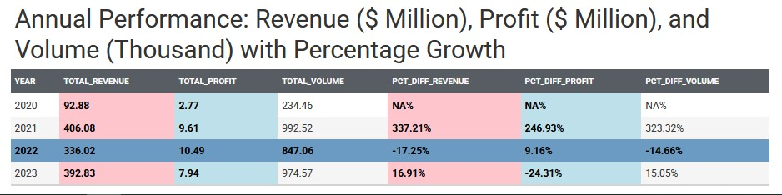

1. Annual Growth Summary.
Did any years experience negative or stagnant growth?. Furthermore, are there significant differences in the data?
2021 delivered a blockbuster performance: Revenue +337%, Volume +323%, Profit +247%.
2022 saw revenue (–17%) and volume (–15%) dip—yet profit still rose by 9%, thanks to cost control.
2023 revenue and volume rebounded, but profit dropped by 24%, signalling operational inefficiencies or pricing challenges.
Key Insights
2021 Set the Gold Standard for Growth and Profit
Olumide Balogun +234-8065060691
10

Slide 11
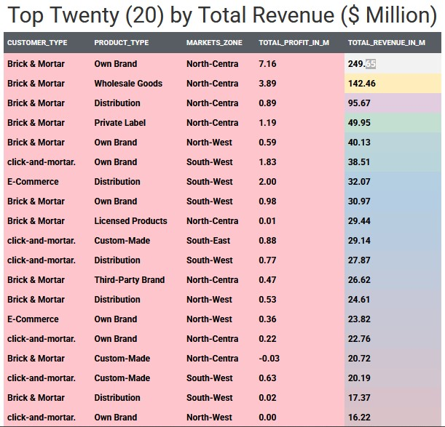
2. Top 20 Revenue Drivers Analysis
Which customer types, product types, and market zones rank among the top 20 with total revenue surpassing $4.00 million?
Key Insights
Brick & Mortar and Own Brand in North-Central are the revenue goldmine
Brick & Mortar accounts for 11 of the top 20 high-revenue segments, especially in North-Central.
Own Brand products shine across all major channels, led by $249M+ in North-Central.
The North-Central region appears five times among the top 10 revenue segments, establishing it as the powerhouse market zone.
Olumide Balogun +234-8065060691
11

Slide 12
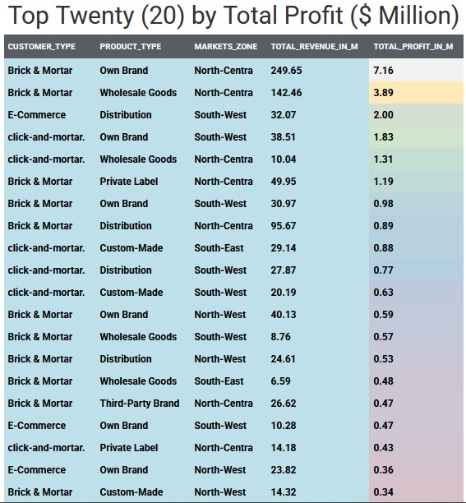
3. Top 20 Profit Drivers Analysis
Which customer types, product types, and market zones rank among the top 20 with total profits exceeding $0.06 million?
Key Insights
Profitability Anchored in Brick & Mortar and Own Brand
Brick & Mortar dominates the top 20 with 11 of 20 entries and accounts for the highest individual profit.
Brick & Mortar – Own Brand – North-Central is the #1 profit generator ($7.16M).
Click-and-Mortar channels are lean and surprisingly profitable.
In regional profit clusters, the North-Central and South-West regions dominate the market zones.
Olumide Balogun +234-8065060691
12

Slide 13
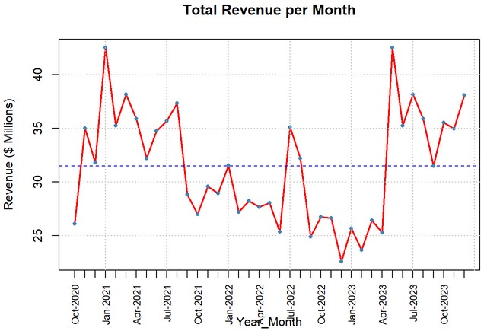
4. Revenue Over Time
Is there a clear upward or downward trend in revenue performance over time?
Key Insights
Overall trend (2020–2023): Growth → Decline → Recovery — with 2023 showing clear signs of renewed momentum
2021 was the growth peak, with strong Q1–Q3 performance and a high of 37.36M in August.
2022 saw a steady decline, dropping from 31.53M in January to 22.56M in December.
2023 began weak but entered a recovery phase mid-year, peaking at 42.52M in May and ending strong in December (38.09M).
Seasonal dips occurred around March–April, while October–December consistently delivered strong results, likely due to holidays and promotions.
Olumide Balogun +234-8065060691
13

Slide 14
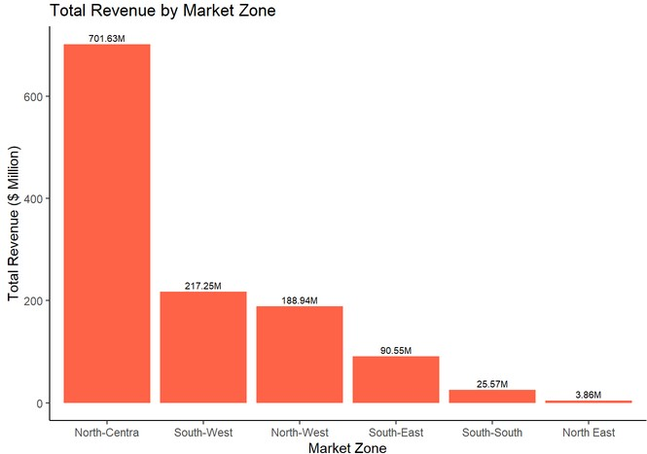
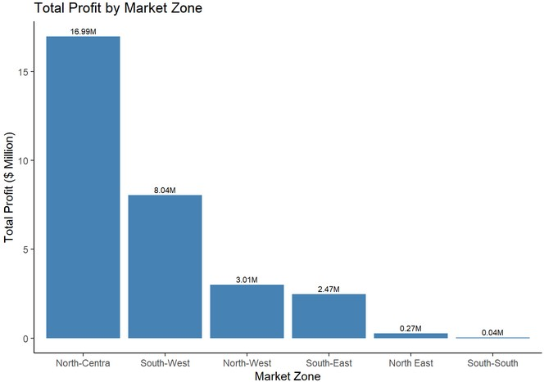
5. Top Market Zone Performance Analysis
How do revenue and profitability differ across various market zones?
North-Central leads with $701M revenue, followed by South-West ($217M). Together, they account for over 70% of total revenue.
North-West comes in third at $188.94 million, suggesting room for growth.
South-East shows moderate performance with $90.85 million.
North-East and South-South lag significantly, they accounted for a total of $30M.
Key Insights
North-Central Reigns Supreme with over $701M Revenue & $16.99 M Profit
Olumide Balogun +234-8065060691
14

Slide 15
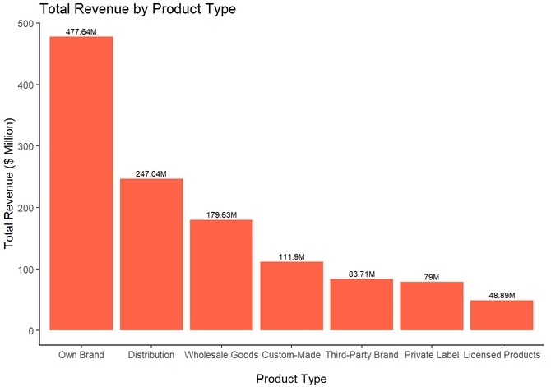
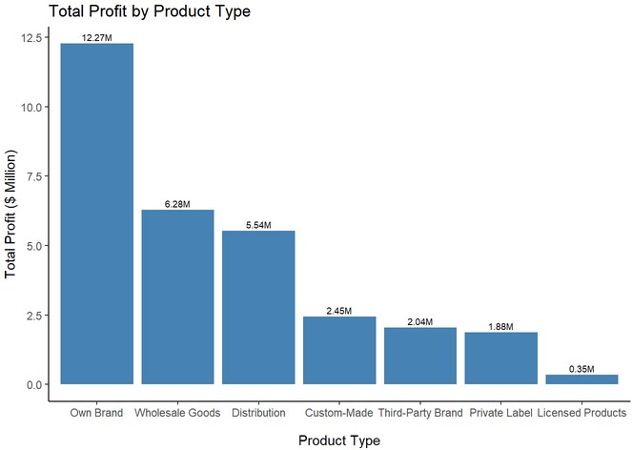
6. Product Type Revenue and Profitability Analysis
How do revenue and profit vary across different product types?
Key Insights
Own Brand leads with $477M revenue and $12.3M profit—highest across the board.
Wholesale Goods delivers high revenue but weaker profit margins.
Custom-Made has lower revenue but strong profit efficiency.
Own Brand Breaks the Charts: Leading with $477.6M Revenue and $12.3M Profit
Olumide Balogun +234-8065060691
15

Slide 16
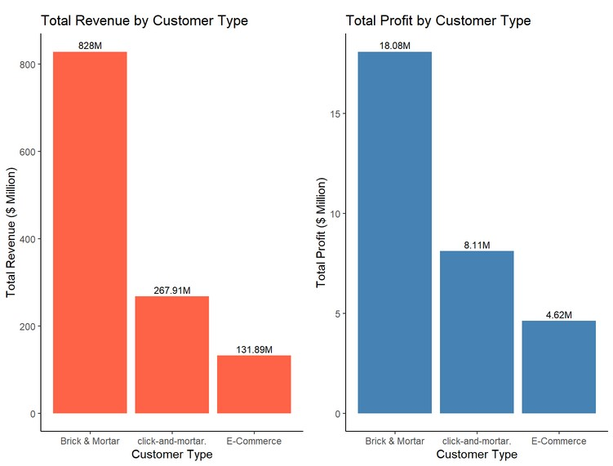
7. Customer Type Revenue and Profitability Analysis
How do revenue and profit vary across different customer types?
Key Insights
Brick & Mortar Is King, Click-and-Mortar Is the Prince
Brick & Mortar leads in both revenue and profit.
Click-and-Mortar performs well with higher margin efficiency.
E-Commerce lags in both, revealing room for digital strategy overhaul.
Olumide Balogun +234-8065060691
16

Slide 17
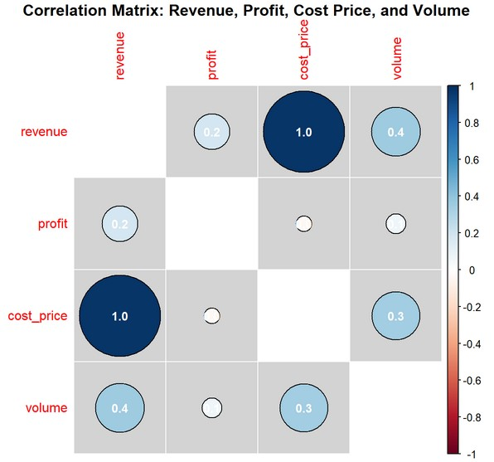
8. EDA and Correlation Analysis with Significance Testing
What are the strengths and directions of relationships between key business variables, and which of these correlations are statistically significant?
Key Insights
Cost, not volume or profit, drives revenue — revealing pricing as the key lever
Revenue vs Cost Price: r = 0.97 (strongest correlation) – Pricing is cost-driven.
Revenue vs Volume: r = 0.35 – Moderate, but not dominant.
Revenue vs Profit: r = 0.19 – Weak link; volume ≠ value.
All correlations are statistically significant (p < 0.001).
Olumide Balogun +234-8065060691
17

Slide 18
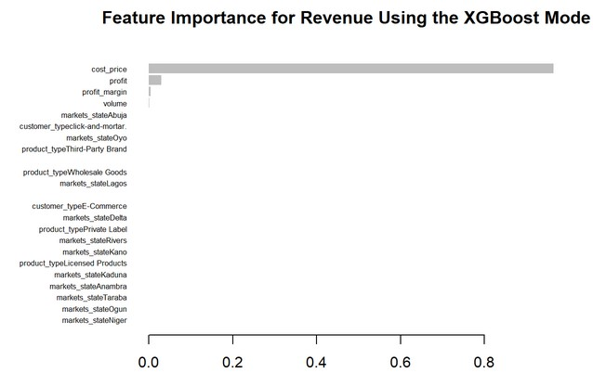
9. Revenue Performance Analysis: Identifying Key Drivers Through Feature Importance & Regression
What key drivers contribute to revenue performance?
Key Insights
Revenue success is deeply tied to cost structure and profitability—not how much you sell or where
Cost Price is the strongest driver of revenue
Profit has a significant and direct impact on revenue
Profit Margin is not a reliable revenue driver
Sales Volume, Customer and Product Type, and Regional (state-level) markets has no significant effect on revenue
Olumide Balogun +234-8065060691
18

Slide 19
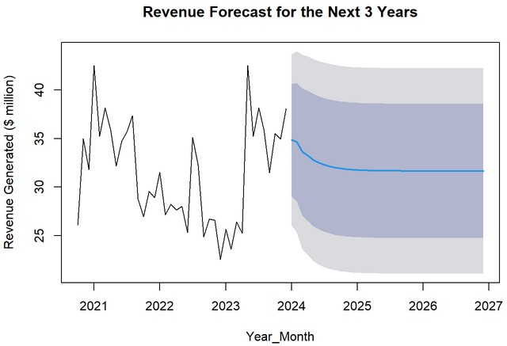
10. Forecasting Revenue Trends: Time Series Insights with ARIMA Modeling
What are the projected revenue trends for the next 36 months, and how can these insights be leveraged to inform strategic business decisions?
Key Insights
Revenue is approaching saturation, with decline in 2024 and stagnation through 2026
Revenue steadily declines from $34.86M in January 2024 to $31.80M in December 2024, reflecting a clear downward trend over the year.
In early 2025, revenue continues to dip slightly before stabilizing mid-year, showing only marginal monthly fluctuations.
By 2026, revenue plateaus at approximately $31.66M, with negligible month-to-month variation, indicating a period of stagnation.
Olumide Balogun +234-8065060691
19

Slide 20
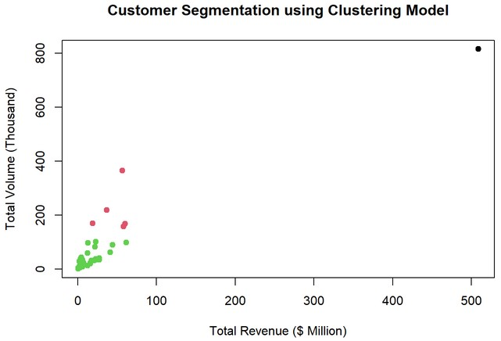
11. Customer Segmentation Using Clustering Techniques
Which customer segments, based on clustering, contribute the most to overall revenue and sales volume?
Key Insights
Prime Stop Superstore in the Black Cluster reigns supreme as a key driver of profitability and long-term business sustainability
Green Cluster – Low Revenue, Low Volume Customers
Represents the majority of customers
Red/Pink Cluster – Mid-Tier Customers
Moderate performance: $44.3M–$61.6M revenue, 89.6K–364K units
Black Cluster – High-Value Customer
Drives $509M+ revenue, 815K+ units sold
Olumide Balogun +234-8065060691
20

Slide 21

1. Replicate High-Growth Strategies from 2021 Analyze and scale winning tactics from 2021, especially in pricing, operations, and product mix, to reignite sustained growth.
5. Reduce Geographic Concentration Risk Invest in South-East, North-West, and other under-leveraged zones to diversify revenue streams and mitigate market dependency
Final Recommendations
2. Address 2023’s Profit Decline Conduct in-depth margin analysis to pinpoint cost inefficiencies and pricing gaps that eroded profitability despite sales recovery
6. Leverage Predictive Analytics Use ARIMA and other forecasting models to anticipate market shifts, support proactive planning, and avoid stagnation.
7. Strengthen Customer Segmentation and Retention Implement targeted loyalty programs and marketing strategies based on clustering insights to boost LTV (Customer Lifetime Value) and reduce churn.
3. Prioritize High-Margin Products & Channels Focus on Own Brand and Custom-Made products in Brick & Mortar and Click-and-Mortar channels to maximize ROI.
4. Revamp Underperforming Channels Optimize E-Commerce operations and expand hybrid retail strategies in high-potential regions.
8. Enhance Data-Driven Decision-Making Culture Institutionalize analytics across teams by enabling regular performance tracking, scenario modeling, and dynamic reporting.
Olumide Balogun +234-8065060691
21

Slide 22

1. Business Growth Optimization
Achieve 15–20% revenue uplift by replicating 2021’s success strategies.
Reduce profit volatility by 10% through smarter product mix and cost control.
Improve profitability by 8–12% by focusing on Own Brand and Wholesale Goods.
Key Expected Outcomes and Estimated Business Impact
2. Operational Efficiency & Smarter Decision-Making
Increase margin accuracy and pricing efficiency by 15–18% via regression analysis.
Enhance forecasting precision by 25% using ARIMA modeling.
Improve decision-making speed by 30% through real-time insights.
3. Market Expansion & Channel Optimization
Boost market penetration by 10–15% in high-growth zones (South-East, North-West).
Achieve 12% growth in hybrid channels (Click-and-Mortar) via omnichannel strategies.
Lift digital sales by 7–10% through E-Commerce optimization and targeting.
Olumide Balogun +234-8065060691
22

Slide 23

Implementation Plan
1. Immediate Actions (0–6 Months)
Audit 2023 profit decline and stabilize margins.
Scale top-performing Own Brand products and regions.
Activate forecasting models (ARIMA) for planning.
Launch segmentation-based loyalty campaigns.
Optimize pricing using regression and correlation insights.
Strengthen Click-and-Mortar channel performance.
2. Short-Term Actions (6–18 Months)
Expand into underperforming regions (e.g., North-East, South-South).
Boost E-Commerce through UX, logistics, and personalization.
Reallocate resources toward high-margin channels and segments.
Enhance operations using predictive analytics and audit results.
3. Long-Term Actions (18+ Months)
Sustain growth via innovative, high-margin products.
Drive geographic and digital expansion through partnerships.
Institutionalize data-driven decision-making with real-time dashboards.
Continuously refine strategy based on feedback and performance trends.
Olumide Balogun +234-8065060691
23

Slide 24

This project provided a clear, data-driven roadmap to optimize revenue, profitability, and strategic growth. Through advanced analytics, we uncovered high-impact trends and performance gaps that empower leadership to take targeted action.
The findings revealed that sustainable growth is driven not merely by sales volume, but by strategic levers such as cost efficiency, product profitability, and channel optimization. The exceptional performance of Own Brand products, Brick & Mortar channels, and the North-Central market zone presents proven, scalable models that can be replicated across other regions and customer segments to maximize impact.
By aligning business strategy with the insights derived from machine learning, regression, and time-series forecasting, the organization can now:
Enhance profitability by up to 12%
Boost revenue growth by 20%
Expand market share across underutilized regions and channels
Improve operational decision-making speed by 30%
The implementation of these recommendations will not only mitigate risk and reduce over-reliance on select zones and segments but will also set the stage for long-term, data-backed strategic evolution.
Act with Intent. Leverage Insights. Scale Success. Lead Strategically.
Conclusion
Olumide Balogun +234-8065060691
24

Slide 25
BALOGUN OLUMIDE CHRIS CONTACTS
Tel: +234(0)8065060691
Email: krisbalo11@gmail.com
Github - https://github.com/olumidebalogun1
LinkedIn -https://www.linkedin.com/in/olumide-balogun1/
Medium - https://medium.com/@Olumide-Balogun
X - https://x.com/IAmOluBalogun
Olumide Balogun +234-8065060691

